Slide 1
Pothole Detection
Yagnahaun Jonnadula
Anurag Peddi

Slide 2
TOC
Introducing: Pothole Detector
Test Plan
Problem Statement
Automation
Development Process
Testing
Likely Impact
Team Size
System Analysis
Management Frameworks
Stakeholders
Competitive Analysis
Change Or Control Management
Requirements
Packaging
Detailed View
Build
Risk Management
Software Subsystems
Hardware Subsystems
Conclusion
The Image Processing Scheme
Brief Overview Of The Model
System UML Diagrams

Slide 3
Introducing: Pothole Detector
Problem Statement
The goal of our project is to design a Pothole detection System which assists the driver in avoiding potholes on the roads, by giving the driver prior warnings. For example, it can be like a buzzer or series of LED, if the driver is approaching a pothole driver may be warned regarding the pothole on the road. In this, we propose a robust and straightforward design of a portable and affordable device that can alert the driver about the detected pothole. The hardware system installed in a moving vehicle can automatically detect and report potholes via image-processing of Raspberry-Pi microcontroller. The detailed images of the pothole and its location are stored and viewed through the GOOGLE API.
Index Terms—Pothole Detection, Hardware system, Raspberry-Pi microcontroller, GOOGLE API.

Slide 4
Likely Impact
01
In this fast-moving world, people want to reach their destinations as soon as possible. Some apps suggest the routes which can make us reach our goal early, and other apps show all possible ways with traffic congestion for whatever reason it may be, such as google maps and many more.
02
But there are fewer apps that tell the condition of the road, whether it is good to travel or not, whether it suggests the route to the driver based on the state of the way. So this model mainly focuses on the travel safety of the passengers and updates the passengers with the best route to travel.
03
Due to weather conditions, improper construction and overloading of vehicles the roads are getting damaged. The scope of the project lies, where the irregularity of the public roads affects the people

Slide 5
Development Process
The strategy utilized to develop the module is Agile model.
Agile Model was selected for the following reasons:
It allows for an improved quality of the product
It focuses on the user reviews about the product
It involves stakeholder engagement with the team
It provides a unique opportunity for clients or customers to be involved throughout the project
Another key benefit of an Agile methodology is that, unlike a Waterfall model, it allows for change in the functionality of the model

Slide 6
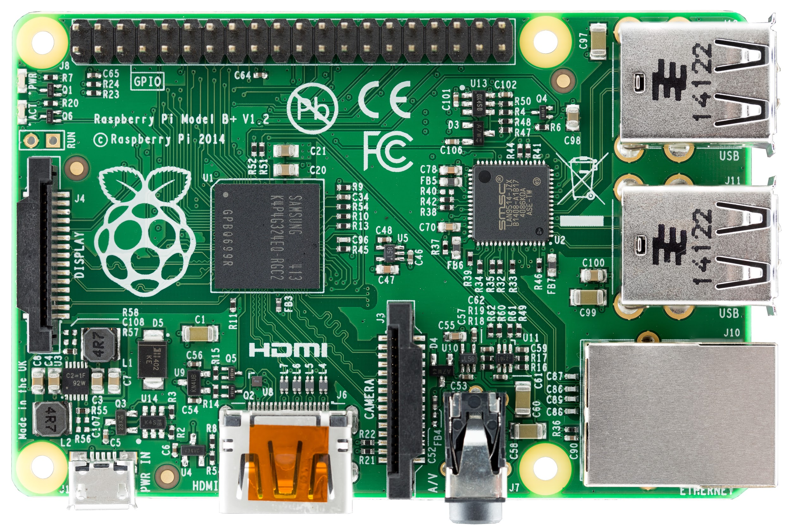
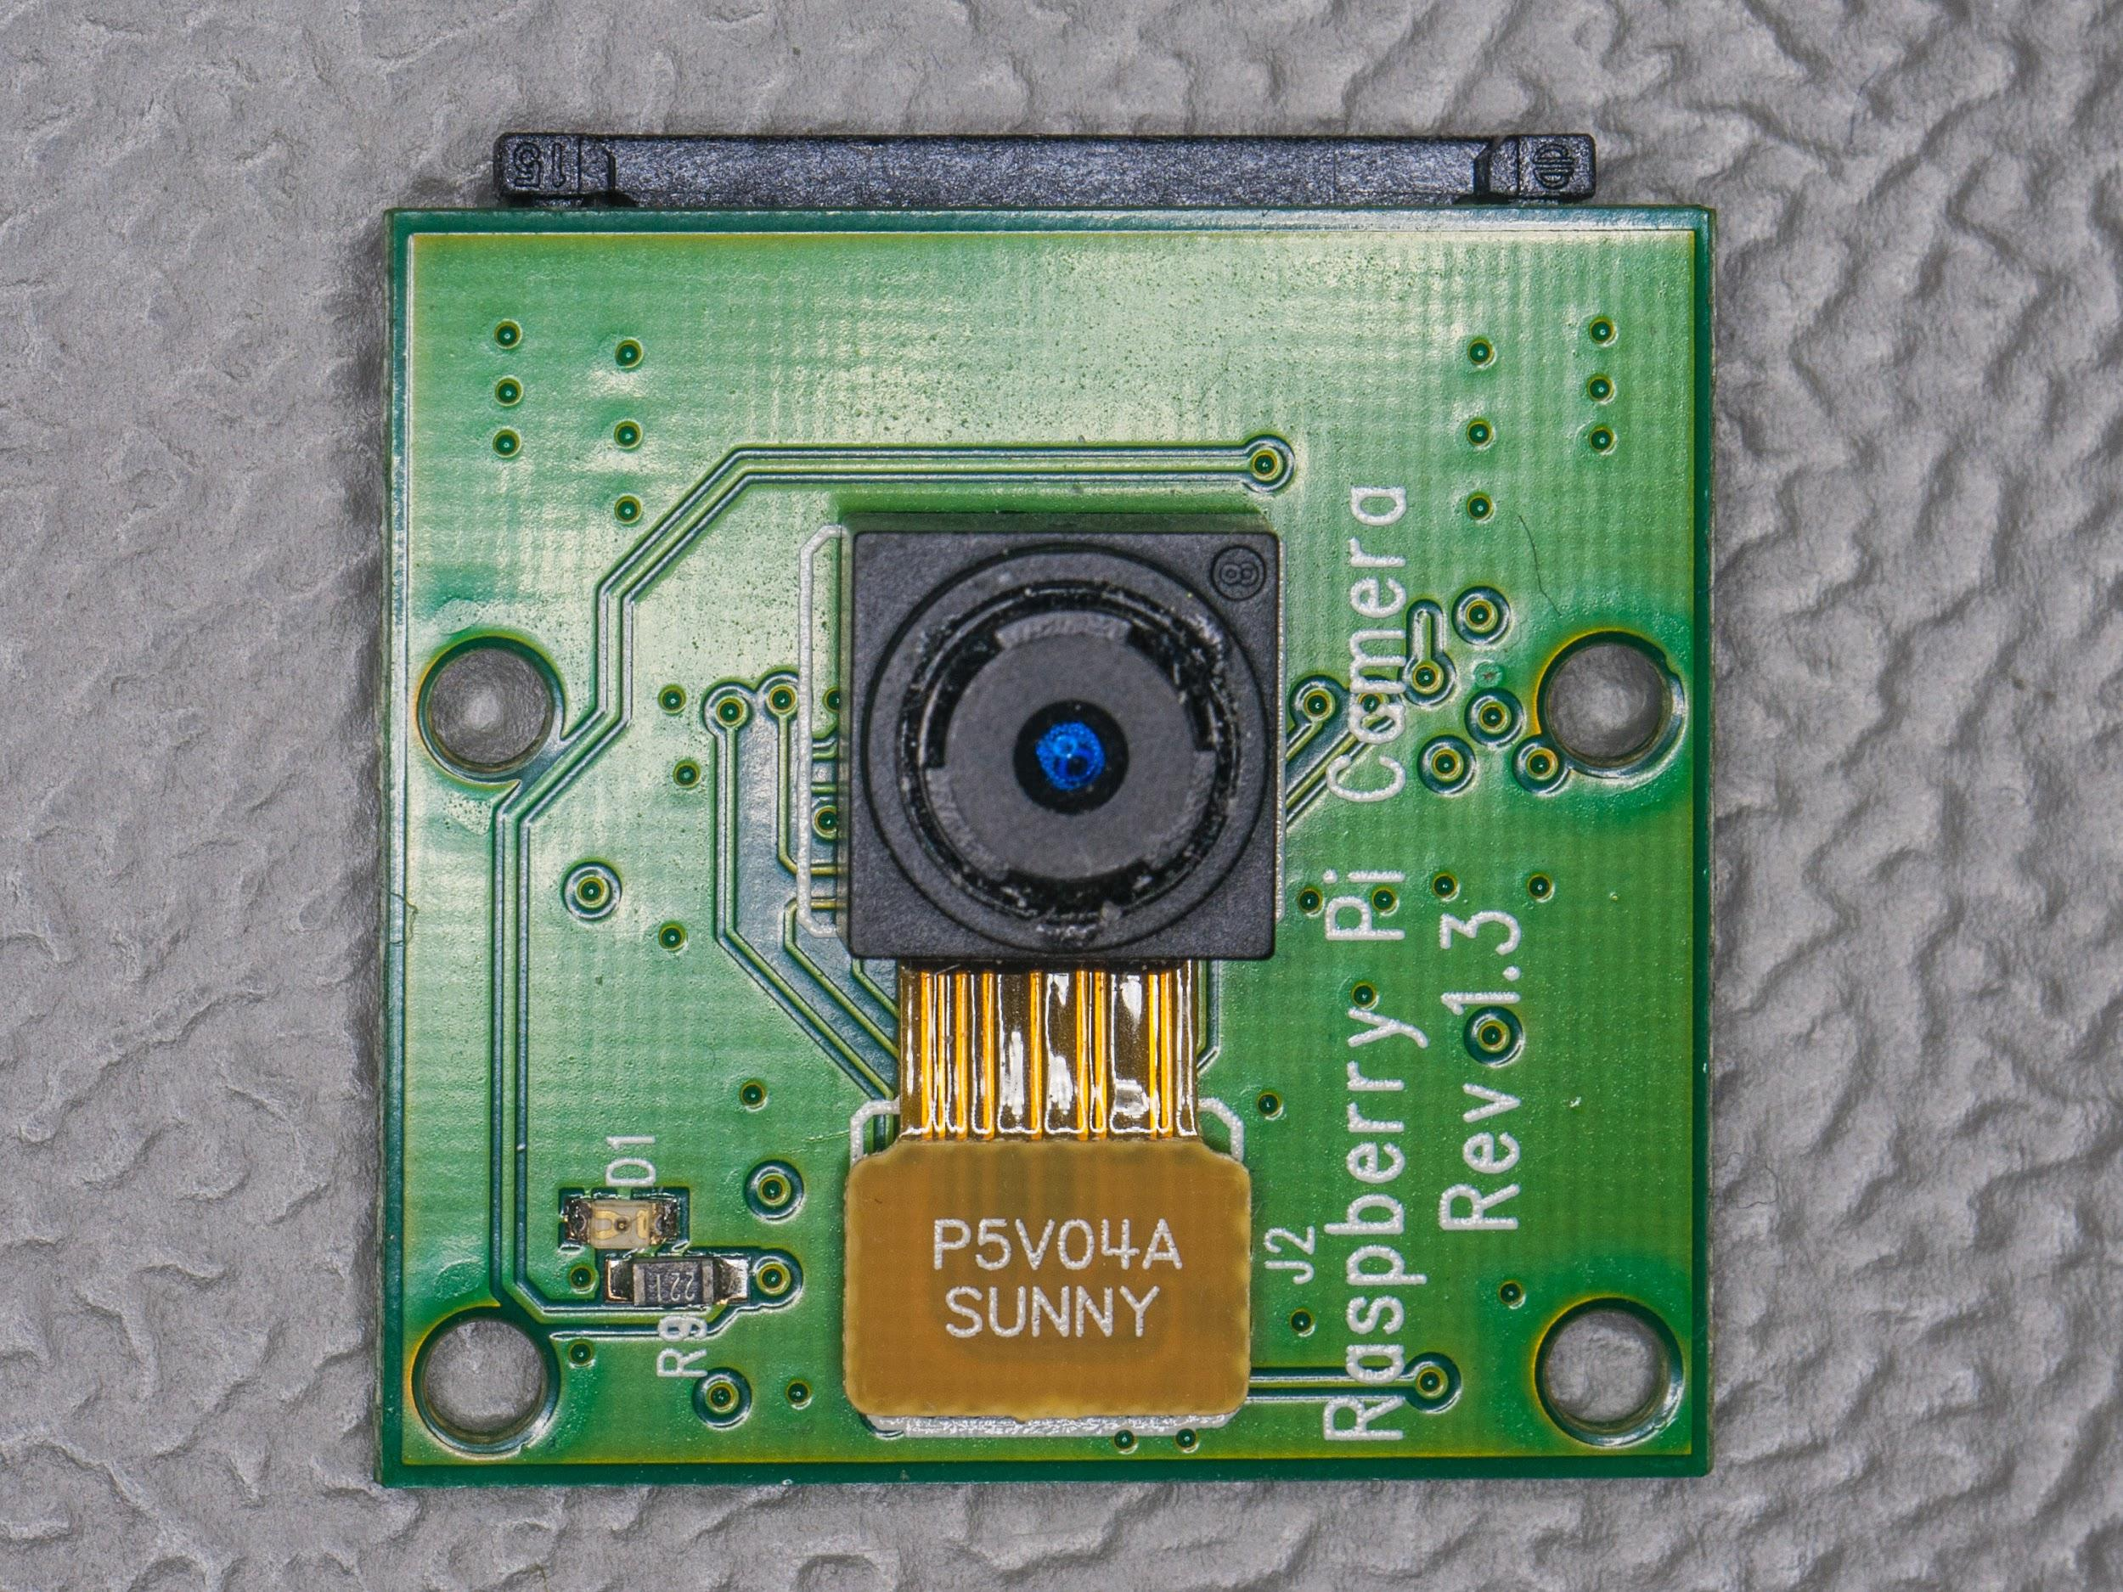

Team Size
The team can be broadly classified into 6 categories:
Software Designer and Developer
Project Team
Database Administrator
Change Control Board
Testers
Analysts

Slide 7
System Analysis
Stakeholders
The below are the stakeholders taking part in the total scenario:
User (Driver)
Data Analyst who takes the data provided by the devices and perform some data analyst.
Software Developer who debugs any issues after the installation.
Project Manager who manages the project.
Tester who tests the model.
Change control board.
Project team.

Slide 8
Competitive Analysis
People in this time need instant solutions for problems; one of the issues is that they need to reach their destinations early, and many applications can do this work. Still, what our app does differently makes us stand out from others, it not only suggests which road reaches your destination faster but also indicates which route is most safe to travel.
The work which can be done by our app is the most critical work, which makes it to find its way into the minds of the users.

Slide 9
Requirements
The embedded device processes the incoming stream of video and detects any pothole in the flow, if any, it immediately intimates the user with a signal. It also saves the information of pothole identified and coordinates in a file for cross-validation.
01
The system should be restarted every 6 hrs, for the cache to flush and the pi camera should be replaced every 5 years for the model to work properly.
02
The user need not to provide any of their confidential details for the module to work.
03
For the module to work, the car should be running and should also limit their speed to under 40kmph.
04
As we are using a pre-trained model for detecting the potholes, the time constraints will be on alert the driver about the pothole and suggesting to him the best and safe possible route.

Slide 10
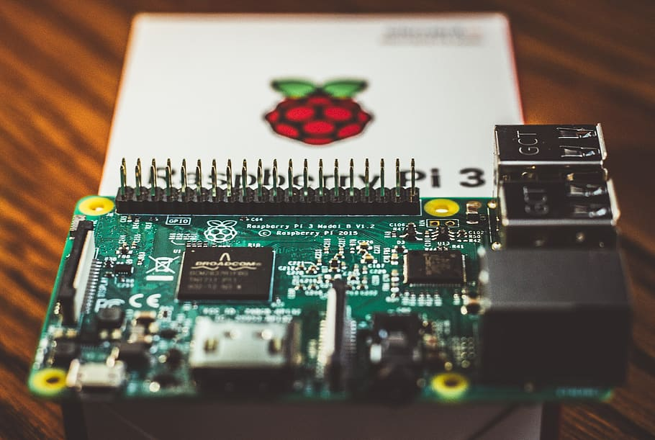
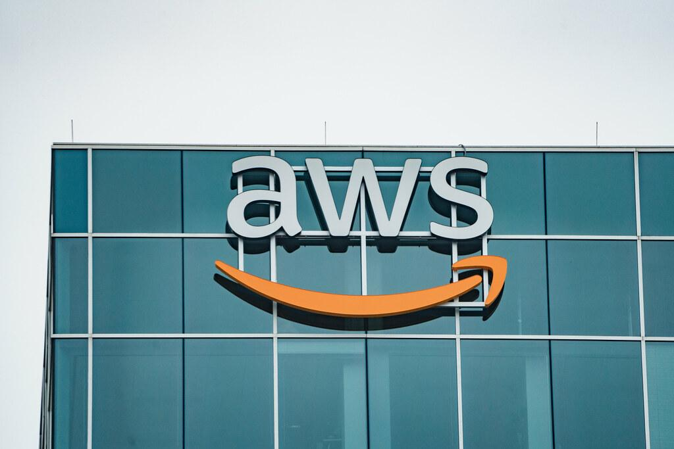
Hardware Sub-System
Raspberry Pi 3
Raspberry Pi 5MP Camera Module
Mini Night Vision Camera 1080P
Jumper Wires
Detailed View
Raspberry Pi 3
Software Sub-System
AWS CloudBuild
AWS Config
AWS

Slide 11
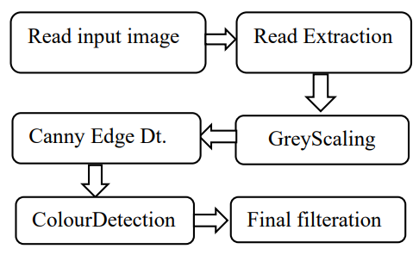
The Image Processing Scheme

Slide 12
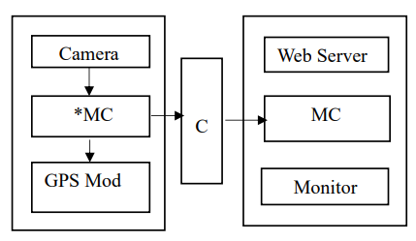
Brief Overview Of The Model

Slide 13
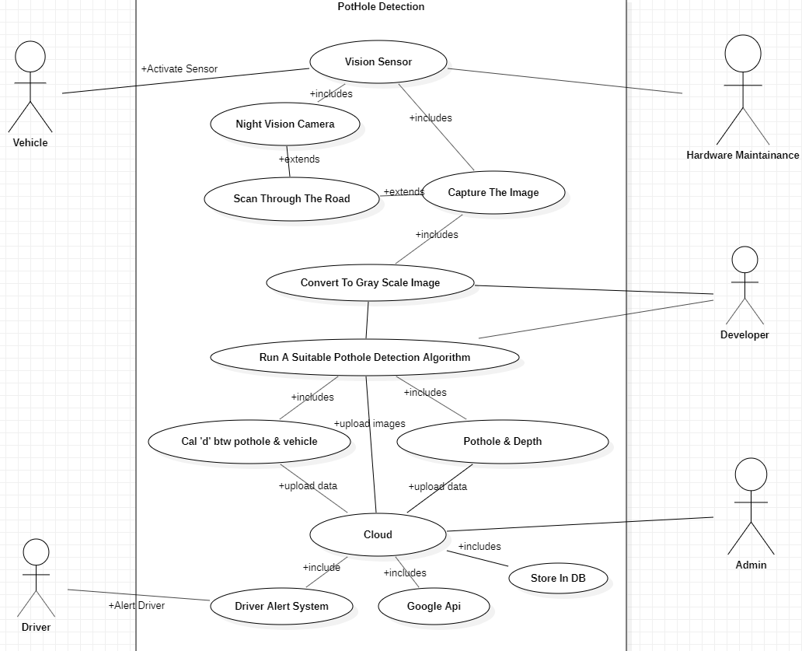
System UML Diagrams
Use Case Diagram

Slide 14
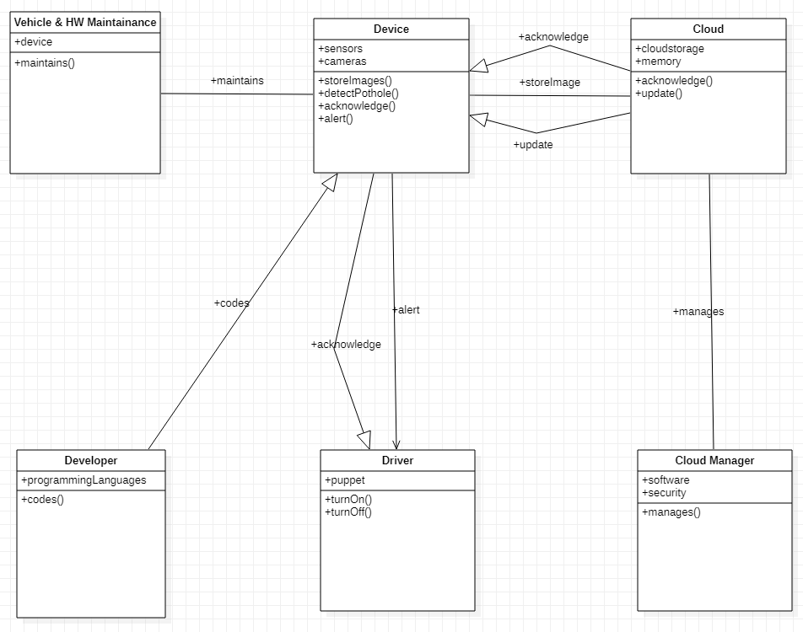
Class Diagram

Slide 15
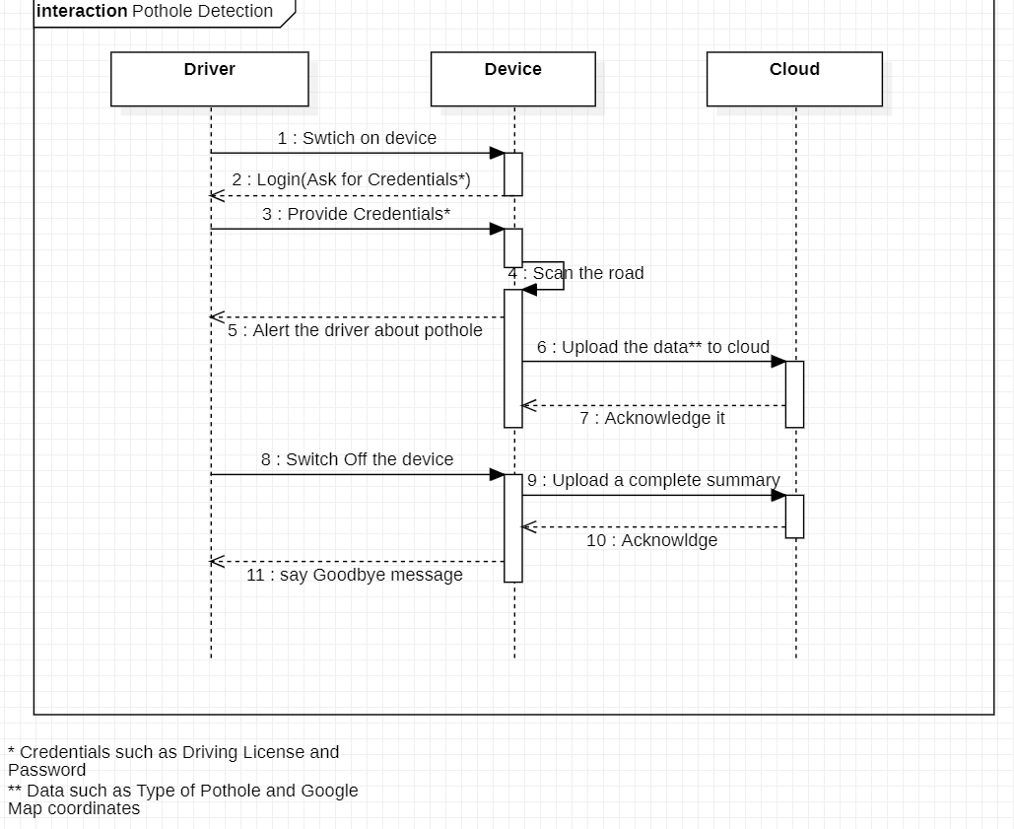
Sequence Diagram

Slide 16
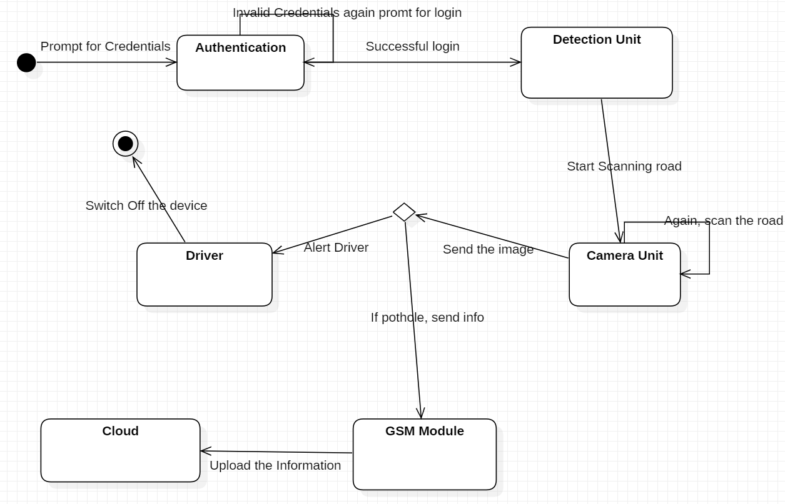
State Diagram

Slide 17
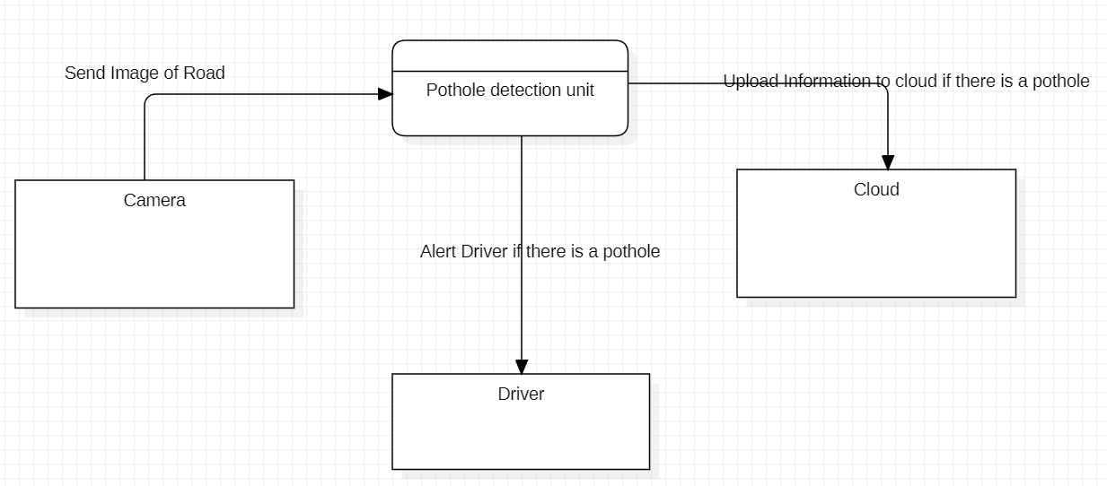
Level 0 Data Flow Diagram

Slide 18
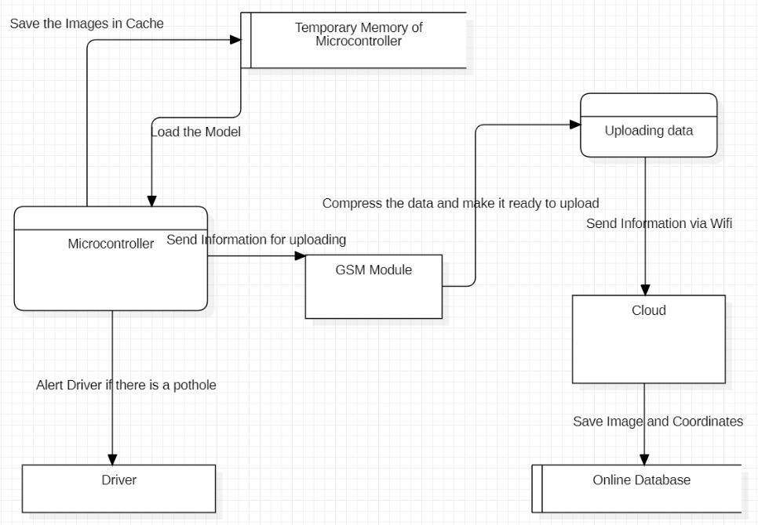
Level 1 Data Flow Diagram

Slide 19
Test Plan
Automation
04
This device assists the driver in avoiding potholes on the roads, by giving the driver prior warnings.
When the device is switched on, the device scans through the road.
01
03
It uploads the location and image of the pothole to the cloud
If the device finds any pothole it runs through the algorithm programmed in it.
02

Slide 20


Testing
Unit Testing
Software test automation tools enable you to simplify testing and reduce time to release by automating functional tests for your applications. Unit testing tools which we are going to use are:
• Pytest
• Travis CI
Travis CI
Pytest

Slide 21
Validation Testing
For validation testing, we use the images which we have collected from sites to check whether all the scripts are bug-free. This validation testing is also done out during the demonstration to our stakeholders(excluding developers).
Defect Testing
For defect testing, we record some real-world videos of road and present it, which not only includes images of the road but also pictures of some patterns which are similar to potholes, to measure how accurate it is detecting potholes when both potholes and potholes like patterns are present.

Slide 22
Management Frameworks
Change or Control Management
Replacement of raspberry pi should be made once every five years and additional updates every month. AWS Config is a service that let's assess, audit, and evaluate the configurations of AWS resources which we are using.
Build
The version control system which we are using is git. AWS CodeBuild is a fully managed continuous integration service that compiles source code, runs tests, and produces software packages that are ready to deploy.
Packaging
To make the python scripts standalone, we are using a package called pyinstaller. AWS packaging automates the process of packaging and publishing software to managed Windows and Linux instances across the cloud landscape, as well as to on-premises servers, through a single simplified interface.

Slide 23
Project timeline
MAR 12, 2020
APR 19,2020
SEPT 15, 2020
DEC 10, 2020
JAN 1, 2021
FEB - MAR, 2021
First phase idea completion
Completion of planning of designing the model(Designing of the working model)
Purchase of all the units required for the model
Assembling the units to a well designed model and required coding
Testing the model with all data sets
The final model that is ready to deliver

Slide 24
Risk Management
Risks
The hardware risks which the device faces is external accidents/shocks, which are unpredictables example:
• Someone hitting it
• Snow covering the lens
• The camera being covered by some object(paper).
• Rainwater going into the circuits and frying them.
And the some of the software risks are privacy and security of data. Time to time updates about the potholes to the cloud and intimate the driver about it correctly . The data should be transmitted only in a secure environment.

Slide 25
Risk Mitigation
Hardware
The above hardware risks can be avoided if the device have a dedicated slot where it is safe enough and should detect the potholes as well.
Software
The privacy and the security of the device should be maintained by a good security analyst so that it would not be lost. And the software developer should schedule time to time checks about the cloud management and the software.

Slide 26
Conclusion
Challenges
The challenges in front are, the budget as we cant take that to a high budget model so that it can be used by many and should get a high pixel camera with a low budget and the model should not make false interpretations of the pothole and make the user feel sure about this model.
Possible Extensions
There could be even more possibilities of extending the model to a state at which it not only detects the potholes but also detecting the fixed potholes and updating the earlier data and detecting speed breakers where the drivers need to slow down. Another extension that we can make is to estimate the depth of the pothole and to categorize them to a different different level of danger and alert the driver about that danger, whether he can travel on that road or not. And can be notified to higher officials for the fixing of these potholes.
• To make it budget-friendly.
• Reduce the latency between the uploads.
• Detect potholes even when the car is at a very high speed.

Slide 27

Thank you!
Our work can be found at
https://github.com/yagnahaunj1410/Pothole_Detection_Using_Image_Processing
And
https://github.com/AnuragAnalog/Pothole-Detection

